Slide 1

YEAR 7 DANCE

Slide 2
Lesson Objective
REHEARSE AND PERFORM OLYMPIC GAMES ROUTINE.
SET TARGETS TO IMPROVE YOUR CHOREOGRAPHIC SKILLS.

Slide 3
Success Criteria
Level | Dance Strand
 | 1 Creating | 2 Performing | 3 Reflecting
E Entry | I can remember a range of actions I can create phrases based on a stimulus or music | I can participate in a short group performance I show some consideration of spatial awareness in performance | I can recognise when my own work and the work of others’, could be improved
1 G | I can perform simple dance phrase demonstrating choreographic skills | I can use appropriate characterisation in a performance | I can talk about why I made certain decisions in my choreography I can show a basic understanding of how a stimuli can be conveyed
2 F | I can create a choreography using unison and cannon I can learn teacher led sequences and then use these to develop my own levels I can create a choreography using a range of stimuli I can take on feedback to improve my choreography such as using levels and/or contract work I can sustain a focus within a performance | I can learn a routine and take part in simple performances | I can give suggestions on how work could be improved I can talk about my work using some dance terminology I can identify strengths and weaknesses in my own and others work
3 E | I can select and apply movement to match the given dance style I can work confidently in a group using a range of choreographic devices to explore different dance styles and ideas I can create and rehearse performance that make use of the range of techniques and dynamics to express my ideas I can give and accept suggestions to/from peers and teachers during the rehearsal process I can learn and create dances in a variety of styles | I experiment with different actions to create a performance I can create routines that are appropriate to the given style or stimuli I can experiment with different styles/actions and dynamics when developing a routine I improve and refine my performance through the rehearsal process I can choreograph a short performance for an audience I can perform a variety of different dance styles | I can reflect on and evaluate my own and other pupils’ work, suggesting improvements I can use key words when talking about dances that I have seen or participated in I can discuss the ways that ideas are communicated

Slide 4

STARTER ACTIVITY
SET 2 TARGETS THAT YOU AIM TO ACHIEVE IN TODAY’S LESSON FOR YOUR ASSESSMENT.

Slide 5
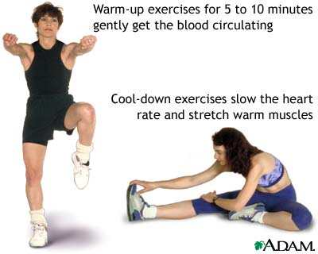
TASK ONE
FOLLOW THE CIRCUIT WARM UP IN GROUPS OF 5/6

Slide 6
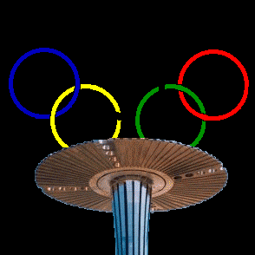
TASK TWO- ASSESSMENT LESSON
5 MINUTES TO REHEARSE YOUR OLYMPIC GAMES ROUTINE. REMEMBER TO WORK AS A TEAM ☺

Slide 7
TASK THREE
EACH GROUP TO PERFORM THEIR OLYMPIC GAMES ROUTINE AND BE RECORDED.
WATCH BACK YOUR PERFORMANCES AND COMPLETE YOUR EVALUATION BOOKLET ON THE PROGRESS YOU HAVE MADE.

Slide 8
PLENARY
WHAT DO YOU FEEL YOU HAVE DONE REALLY WELL AT?
WHAT DO YOU FEEL YOU NEED TO IMPROVE ON?
WHAT GRADE DO YOU AIM TO ACHIEVE BY THE END OF THE TERM?

